Slide 1
Medical Biology – Year 1
Lab 2: The parts of the Light Microscope
By Lecturer: Dr. Hanaa Ali Hussein
Department: Basic Sciences
College of Dentistry
University of Basrah
University of Basrah – College of Dentistry– Basic Sciences

Slide 2
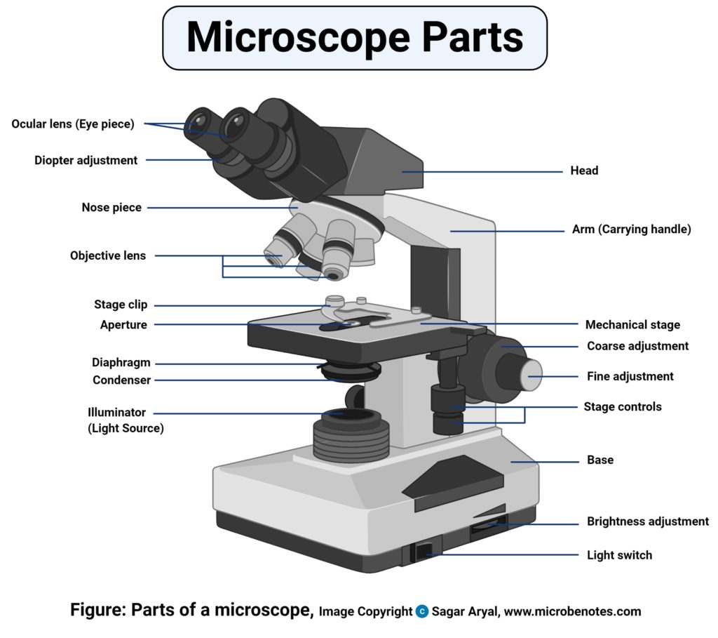
What are the parts of the light microscope?
University of Basrah – College of Dentistry– Basic Sciences
2

Slide 3
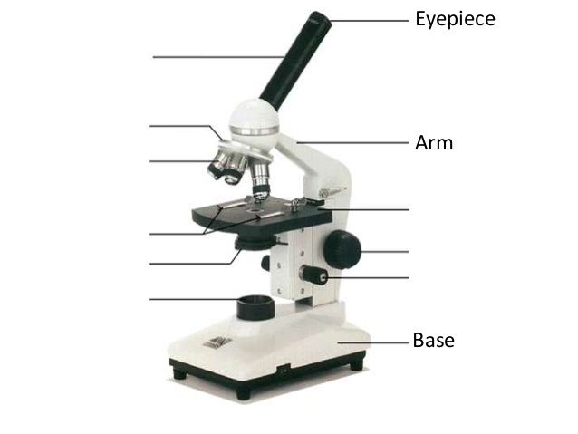
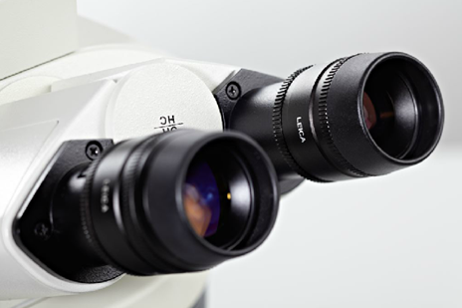
1- Ocular lens: To expose the image of the specimen to the eye. 2- Body tube:- To hold the eyepieces. 3- Prism:- To reflect the image from the objective lens to the ocular lens. 4- Arm:- Supports the tube and connects it to the base
The parts of the light microscope
Ocular lens
Body tube
Prism
Arm
Prism
Body tube
Ocular lens
University of Basrah – College of Dentistry– Basic Sciences
3

Slide 4
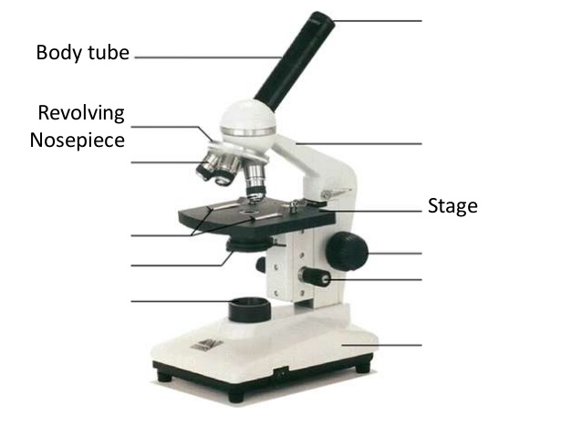
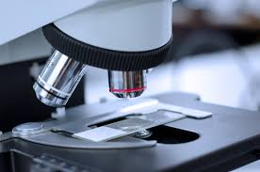
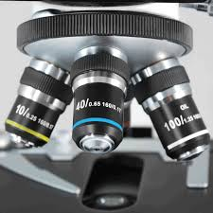
5- Resolving nose piece:- Bearing and turn around several objective lens.
The parts of the light microscope
Resolving nose piece
Resolving nose piece
Objective lens
6- Objective lens:- Usually you will find 3 or 4 objective lenses on a microscope. They always consist of 4X, 10X, 40X and 100X powers.
Objective lens
University of Basrah – College of Dentistry– Basic Sciences
4

Slide 5
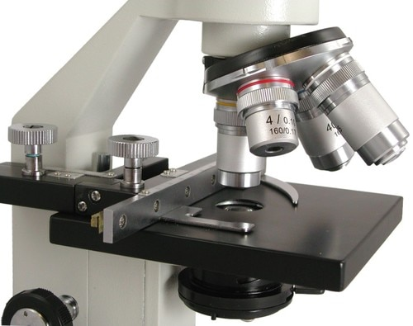
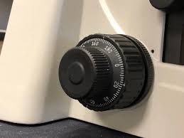
7- Mechanical stage:- The flat platform where you place your slides
The parts of the light microscope
Mechanical stage clips
Mechanical stage
8- Coarse and fine adjustment knobs:-
Moves stage (or body tube) up and down
Coarse adjustment
Fine adjustment
University of Basrah – College of Dentistry– Basic Sciences
5

Slide 6
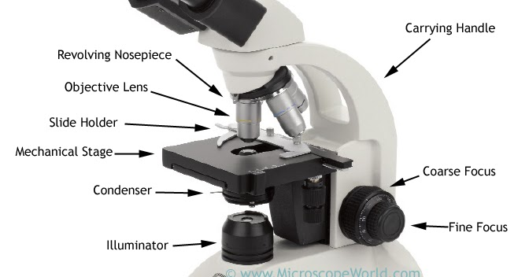
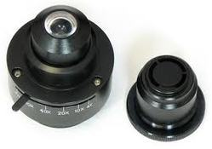
10- Illuminator :- To light up and clarify the specimen.
The parts of the light microscope
11- Base:- To support and fix the parts of microscope.
Base
University of Basrah – College of Dentistry– Basic Sciences
6

Slide 7
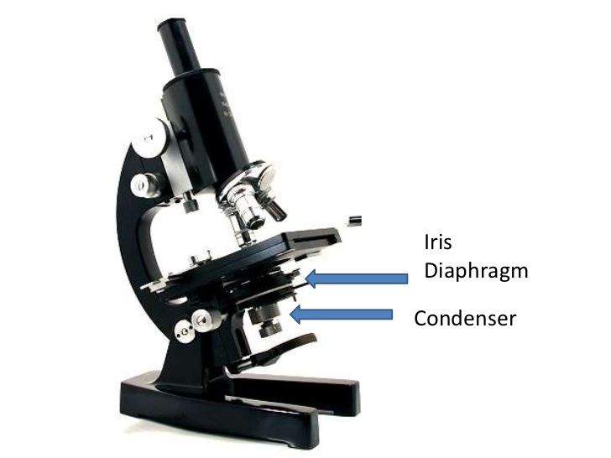
12- Condenser lens and the iris Diaphragm:- To concentrate the light and send it to the specimen to be more lighted 13- Light filter :- To sort unneeded light waves.
The parts of the light microscope
University of Basrah – College of Dentistry– Basic Sciences
7

Slide 8
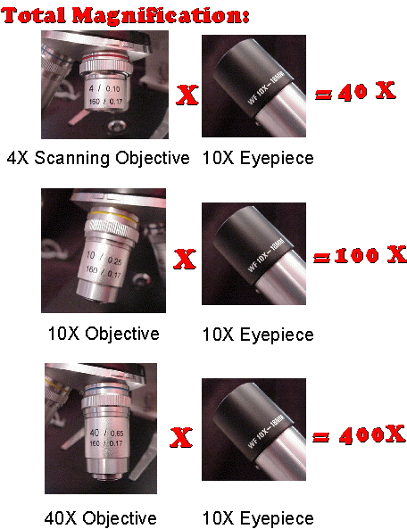
Your microscope has 3 magnifications: Scanning, Low and High. Each objective will have written the magnification. In addition to this, the ocular lens (eyepiece) has a magnification. The total magnification is the ocular x objective
Magnification
Scanning
Low power
High power
University of Basrah – College of Dentistry– Basic Sciences
8

Slide 9
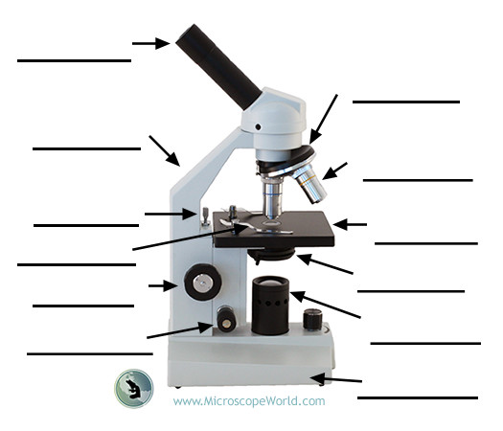
Label the parts of microscope and how measure the magnification?
University of Basrah – College of Dentistry– Basic Sciences
9

Slide 10
Calculate the missing information in the Table?
University of Basrah – College of Dentistry– Basic Sciences
10

